Slide 1
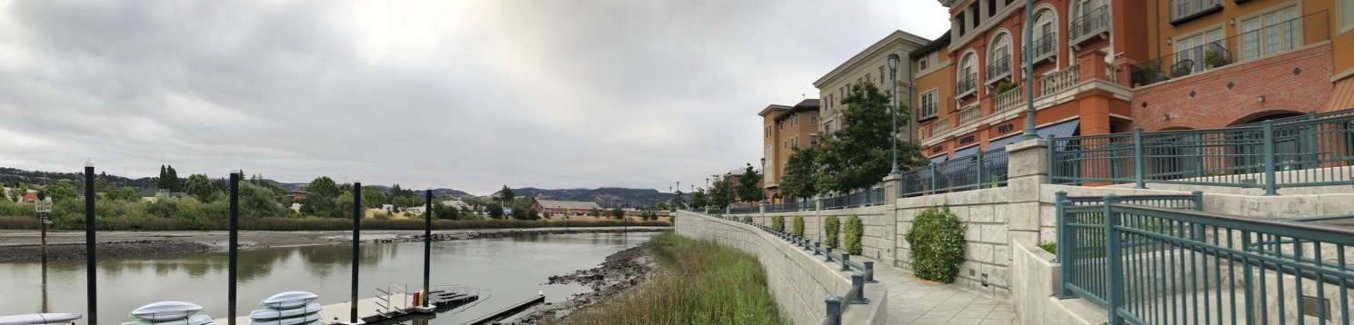


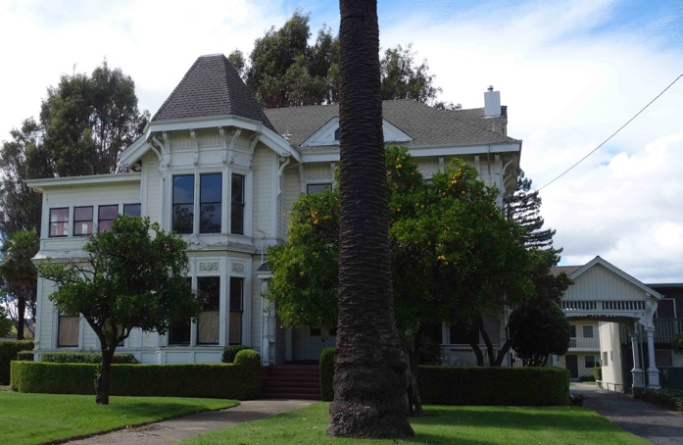
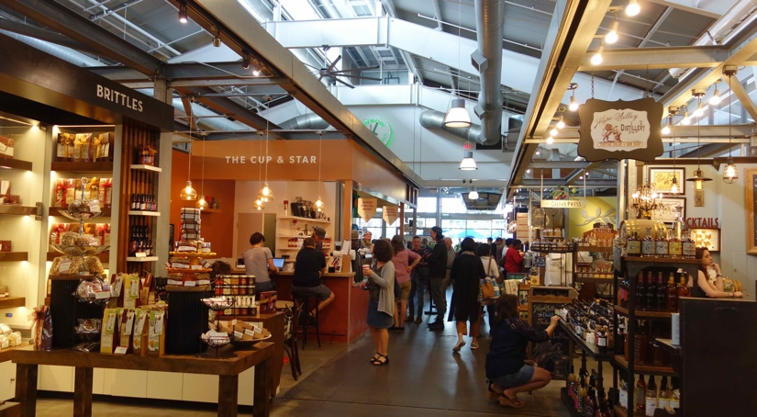
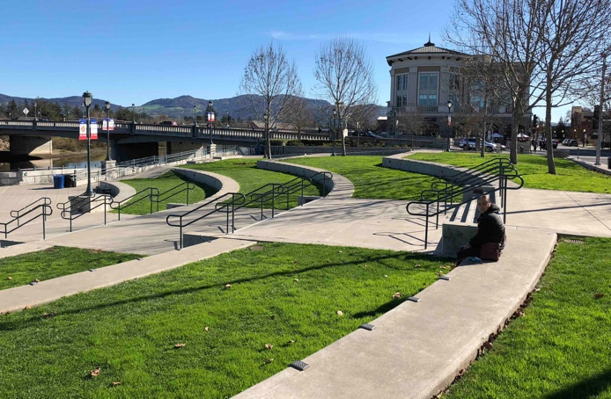
City of Napa General Plan Update
PREFERRED PLAN AND CONCEPTS

Slide 2
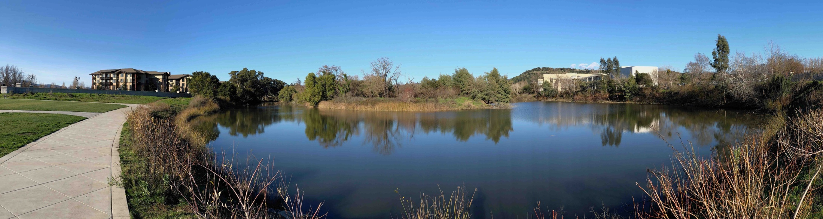
Agenda
General Plan Overview
Vision and Guiding Principles
Focus Areas and Possibilities
Conclusion and Next Steps

Slide 3
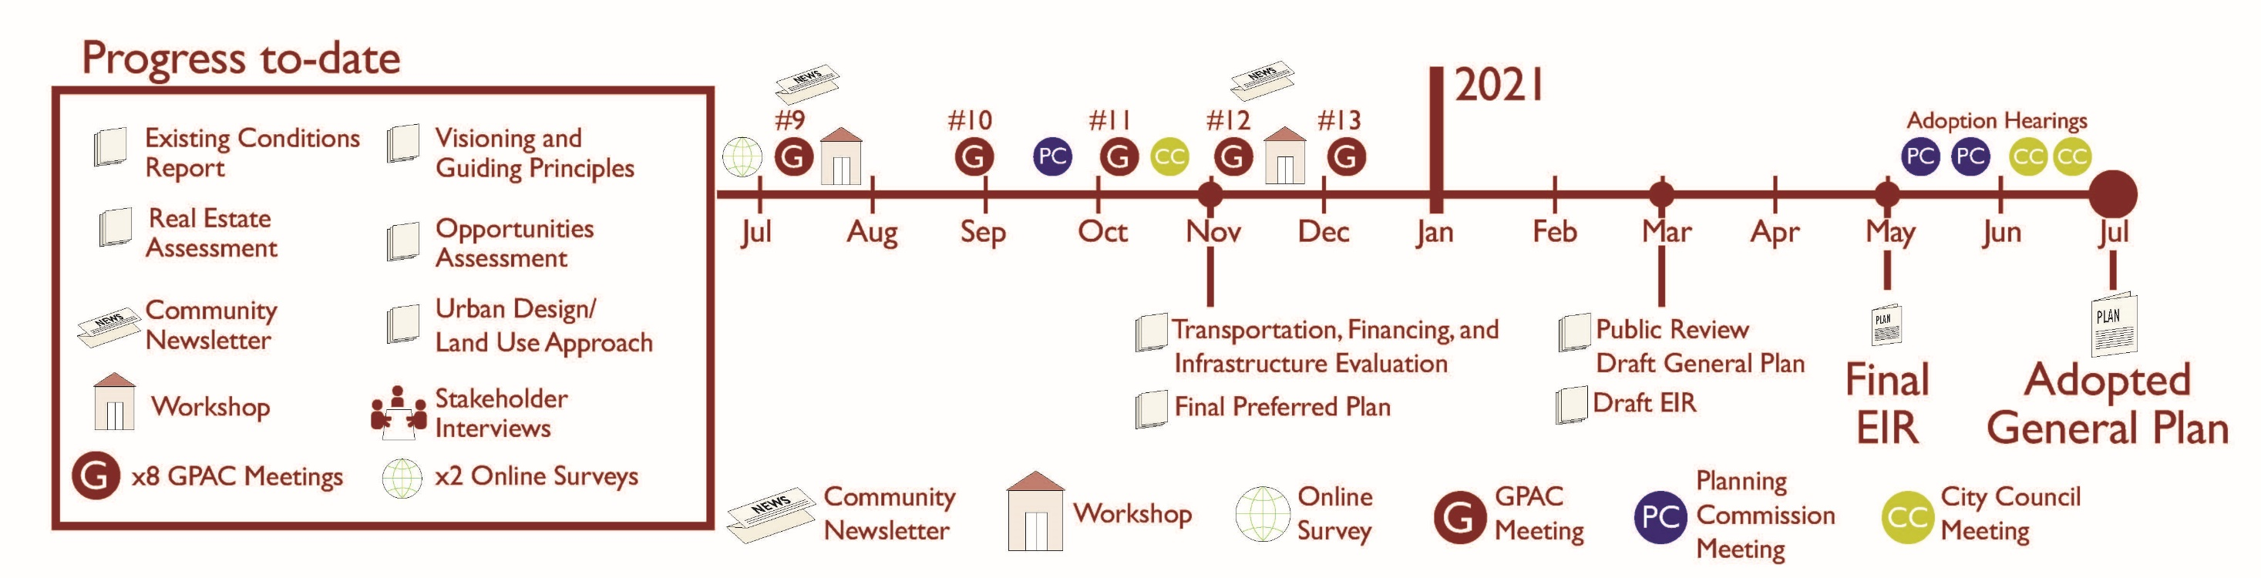
Process and Schedule
We are here
General Plan Policies
Napa2040.com

Slide 4
Who is in this meeting?
Check all that apply
  I live in Napa
  I work/go to school or college in Napa
  I have attended a General Plan meeting or taken a survey

Slide 5
What is a General Plan?
Long-range (20+ years) comprehensive plan
“Constitution for local development”
Expresses a vision for the community’s future
Outlines goals, objectives, and policies to achieve this vision

Slide 6
General Plan Requirements
Comprehensive
  Applies to the entire city/Sphere of Influence
  Addresses a full range of issues affecting Napa’s physical development
Internally Consistent
  Policies, diagrams, and analysis are fully integrated with no conflicts
Other City Plans and Programs Consistent with General Plan
  General Plan
  Specific Plans, Master Plans
  Zoning Ordinance
  Design Standards and Guidelines

Slide 7
General Plan Topics/”Elements”
Land Use
Housing
Transportation
Community Services
Parks and Recreation
Historic Resources
Natural Resources
Health and Safety
Economic Development

Slide 8
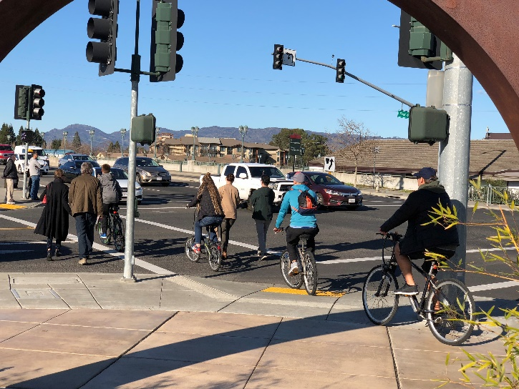
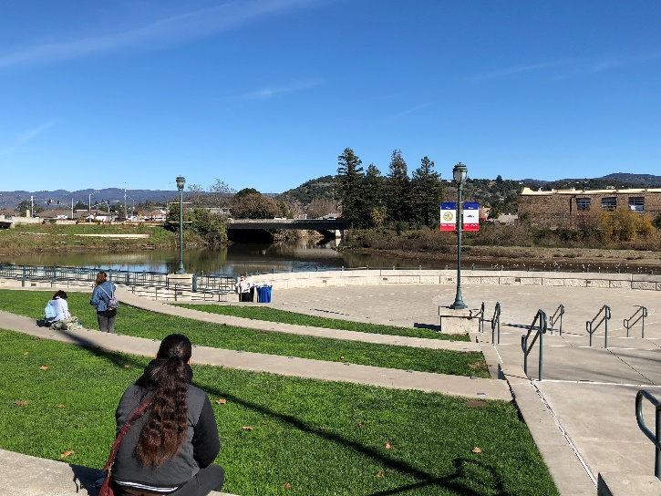
How does the General Plan affect you?
Determines how you and your neighbors can develop and use property
Location for new housing, businesses
How you get around
The look and feel of the Napa community as a whole
Health and safety issues for the benefit of the entire community.

Slide 9

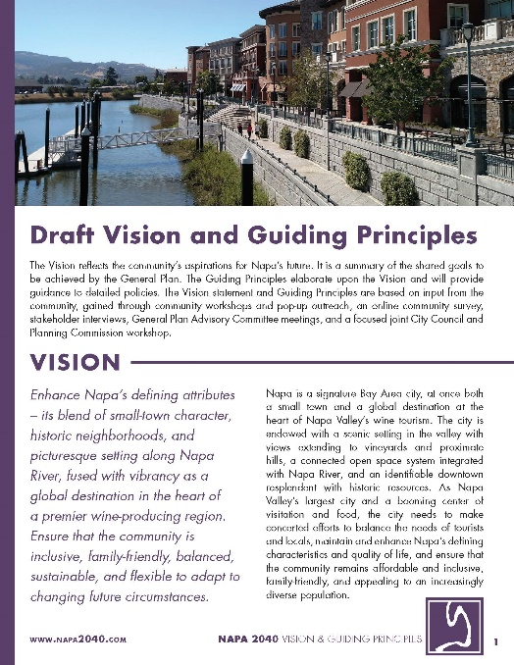
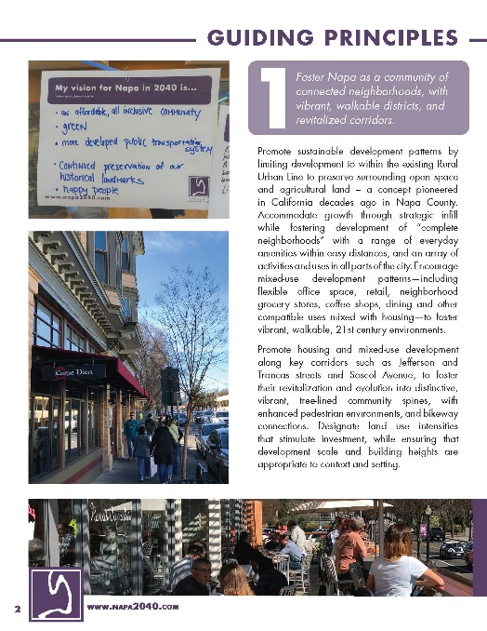
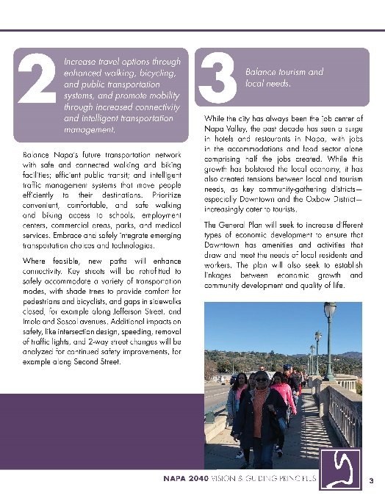
2. Vision and Guiding Principles
Draft Vision and Guiding Principles have been developed based on previous outreach
Will be finalized and included in the General Plan
Available to download and view at Napa2040.com
Notes:
A total of 1,210 persons completed the survey – 936 in the English survey and 274 in the Spanish survey. Forty-seven percent of respondents identified themselves as residents, 24 percent as employed, and 24 percent as both residents and employed in the city. Of those who live in Napa, one third of respondents have lived in the city for over 20 years, 27 percent between 10-20 years, and 36 percent between one and 10 years (Figure 2). The largest age cohort of participants was 45 to 64 years; when compared to the age demographics of the City of Napa, both the 45 to 64 and 65 years and older age groups had proportionally 12 percent more responses than the city’s actual age distribution (Figure 3). Fifty-four percent of respondents identified as female, while 25 percent identified as male, 21 percent did not give a response.

Slide 10
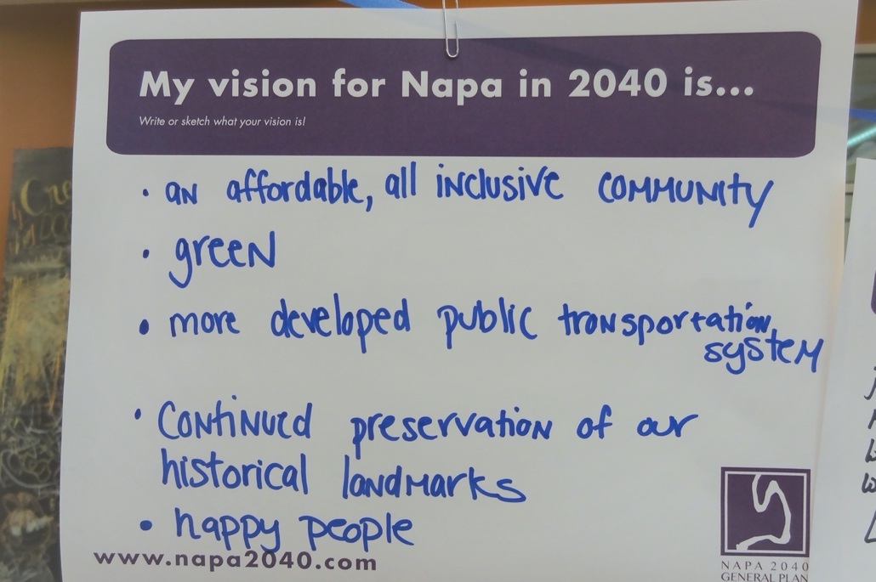
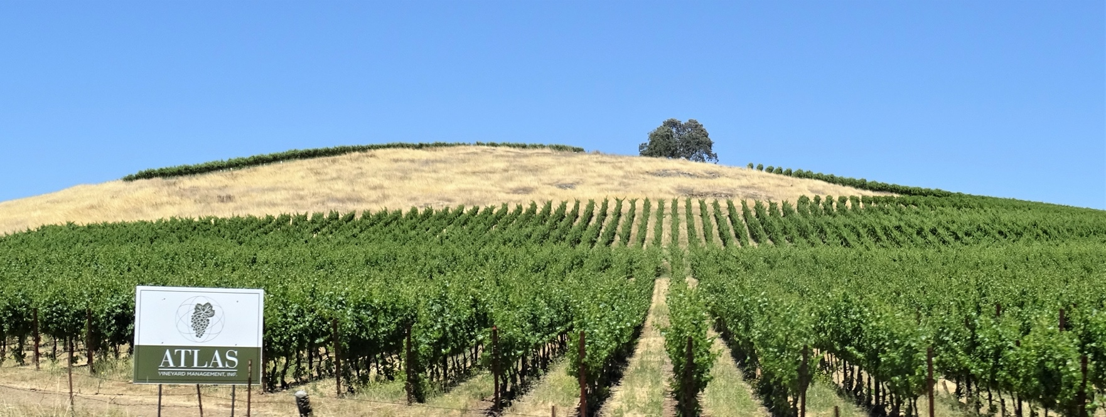
2. Vision and Guiding Principles
Vision Statement:
The Napa community envisions that, in the year 2040, the city will improve the needs of residents first while achieving a sustainable future for all. Enhance Napa’s defining attributes – its blend of small- town character, historic neighborhoods, and picturesque setting along Napa River, fused with vibrancy as a global destination in the heart of a premier wine-producing region. Ensure that the community is inclusive, family-friendly, balanced, sustainable, and flexible to adapt to changing future circumstances.
Notes:
A total of 1,210 persons completed the survey – 936 in the English survey and 274 in the Spanish survey. Forty-seven percent of respondents identified themselves as residents, 24 percent as employed, and 24 percent as both residents and employed in the city (Figure 1). Of those who live in Napa, one third of respondents have lived in the city for over 20 years, 27 percent between 10-20 years, and 36 percent between one and 10 years (Figure 2). The largest age cohort of participants was 45 to 64 years; when compared to the age demographics of the City of Napa, both the 45 to 64 and 65 years and older age groups had proportionally 12 percent more responses than the city’s actual age distribution (Figure 3). Fifty-four percent of respondents identified as female, while 25 percent identified as male, 21 percent did not give a response.

Slide 11
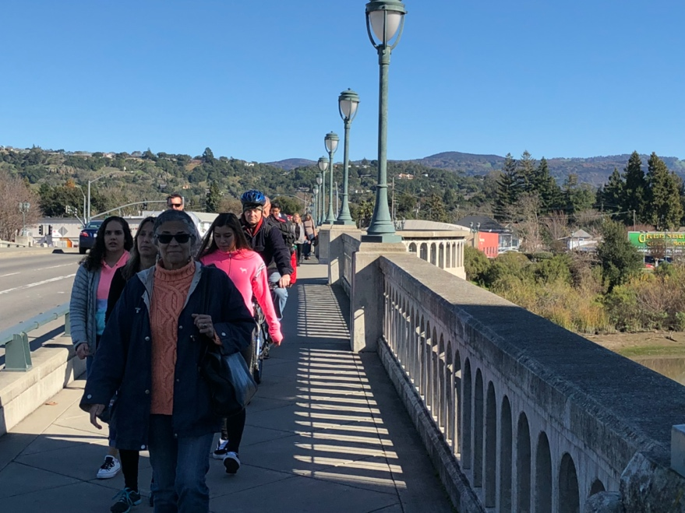
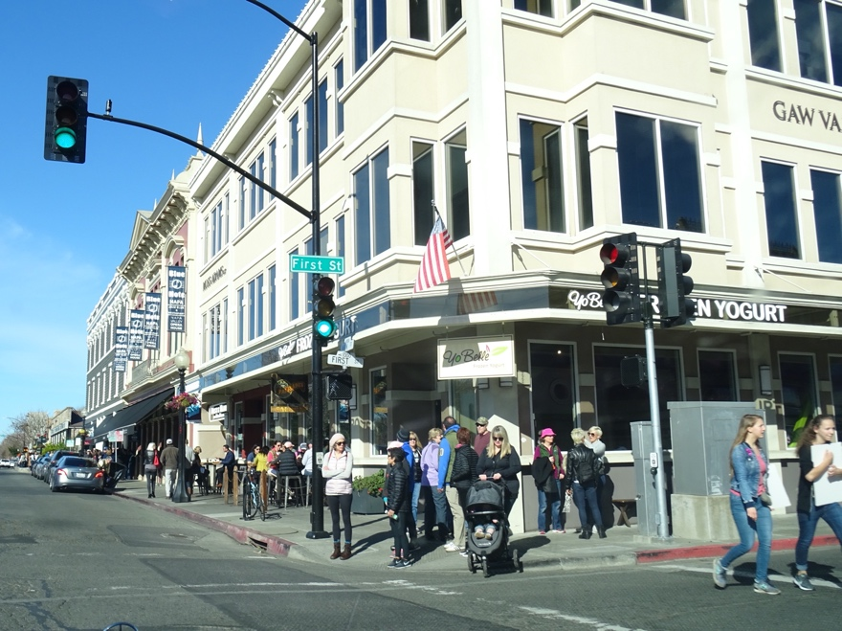
2. Vision and Guiding Principles
Guiding Principles:
Foster Napa as a community of connected neighborhoods, with vibrant, walkable districts, and revitalized corridors
Increase travel options through enhanced walking, bicycling, and public transportation systems, and promote mobility through increased connectivity and intelligent transportation management
Notes:
A total of 1,210 persons completed the survey – 936 in the English survey and 274 in the Spanish survey. Forty-seven percent of respondents identified themselves as residents, 24 percent as employed, and 24 percent as both residents and employed in the city (Figure 1). Of those who live in Napa, one third of respondents have lived in the city for over 20 years, 27 percent between 10-20 years, and 36 percent between one and 10 years (Figure 2). The largest age cohort of participants was 45 to 64 years; when compared to the age demographics of the City of Napa, both the 45 to 64 and 65 years and older age groups had proportionally 12 percent more responses than the city’s actual age distribution (Figure 3). Fifty-four percent of respondents identified as female, while 25 percent identified as male, 21 percent did not give a response.

Slide 12
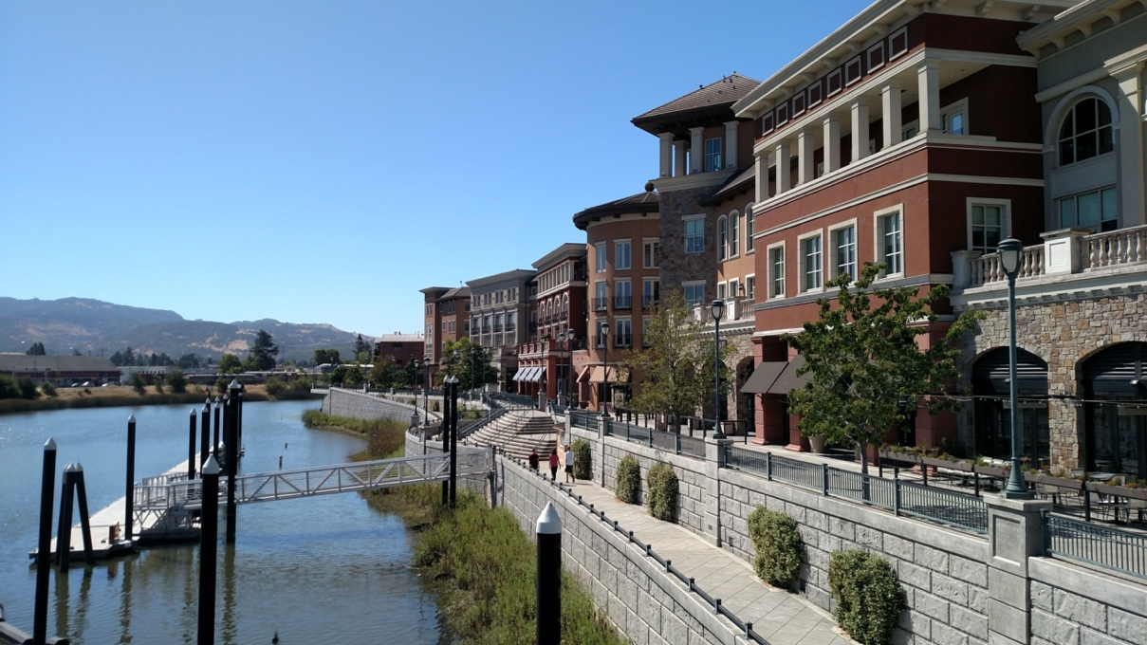
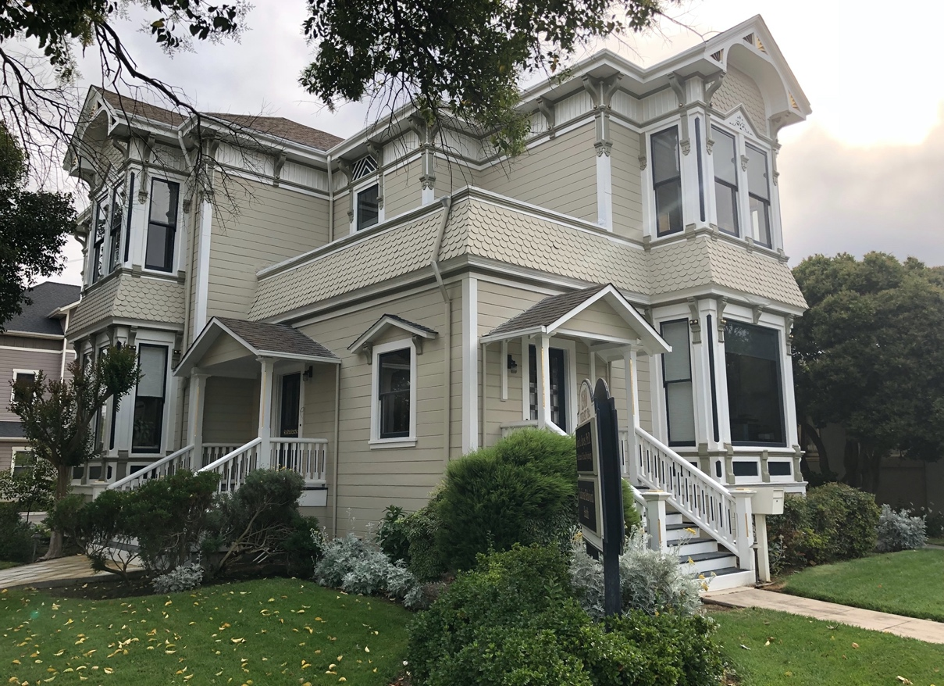
2. Vision and Guiding Principles
Guiding Principles:
Balance tourism and local needs
Promote housing and support a diverse array of housing types to meet the needs of all segments of the population
Foster connections to nature and open space
Notes:
A total of 1,210 persons completed the survey – 936 in the English survey and 274 in the Spanish survey. Forty-seven percent of respondents identified themselves as residents, 24 percent as employed, and 24 percent as both residents and employed in the city (Figure 1). Of those who live in Napa, one third of respondents have lived in the city for over 20 years, 27 percent between 10-20 years, and 36 percent between one and 10 years (Figure 2). The largest age cohort of participants was 45 to 64 years; when compared to the age demographics of the City of Napa, both the 45 to 64 and 65 years and older age groups had proportionally 12 percent more responses than the city’s actual age distribution (Figure 3). Fifty-four percent of respondents identified as female, while 25 percent identified as male, 21 percent did not give a response.

Slide 13
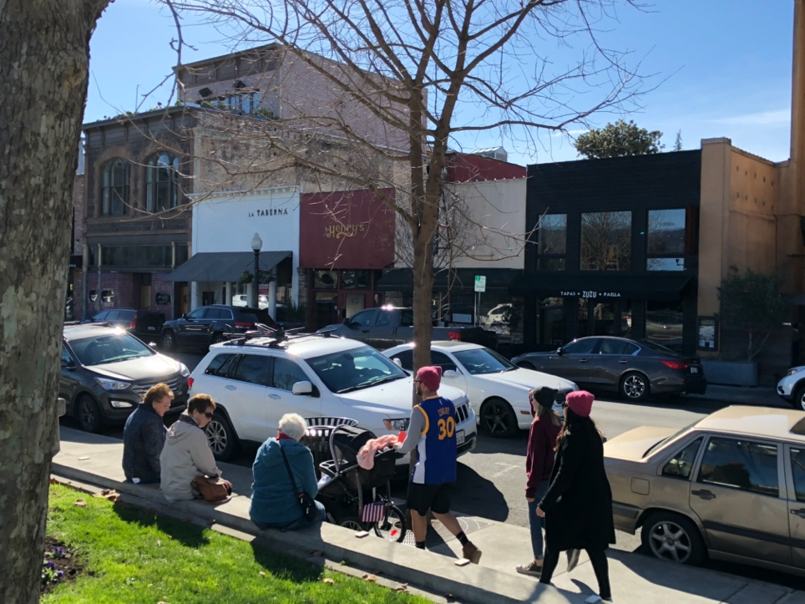
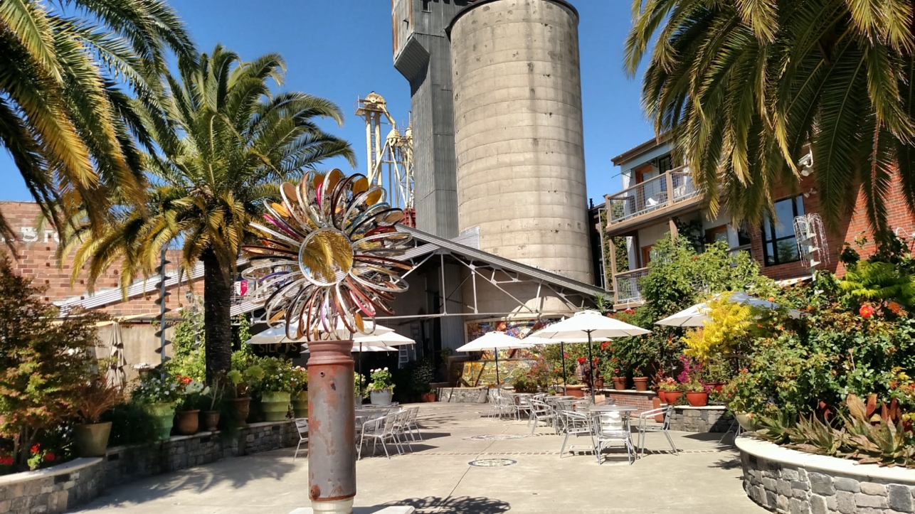
2. Vision and Guiding Principles Review
Guiding Principles:
Emphasize environmental sustainability
Achieve healthy and safe community for all
Promote continued Downtown revitalization
Celebrate culture, arts, and history
Achieve an economically diverse and resilient community

Slide 14
Poll on Guiding Principles
Select the topics that reflect your priorities:
Connected neighborhoods, vibrant/walkable districts, revitalized corridors
Enhanced walking, bicycling, and public transportation systems, intelligently-managed traffic
Balance of tourism and local needs
Housing, support diverse housing types
Connections to nature and open space
Environmental sustainability
Healthy and safe community for all
Downtown revitalization
Culture, arts, and history
Economically diverse and resilient community

Slide 15
3. Focus Areas and Possibilities

Slide 18
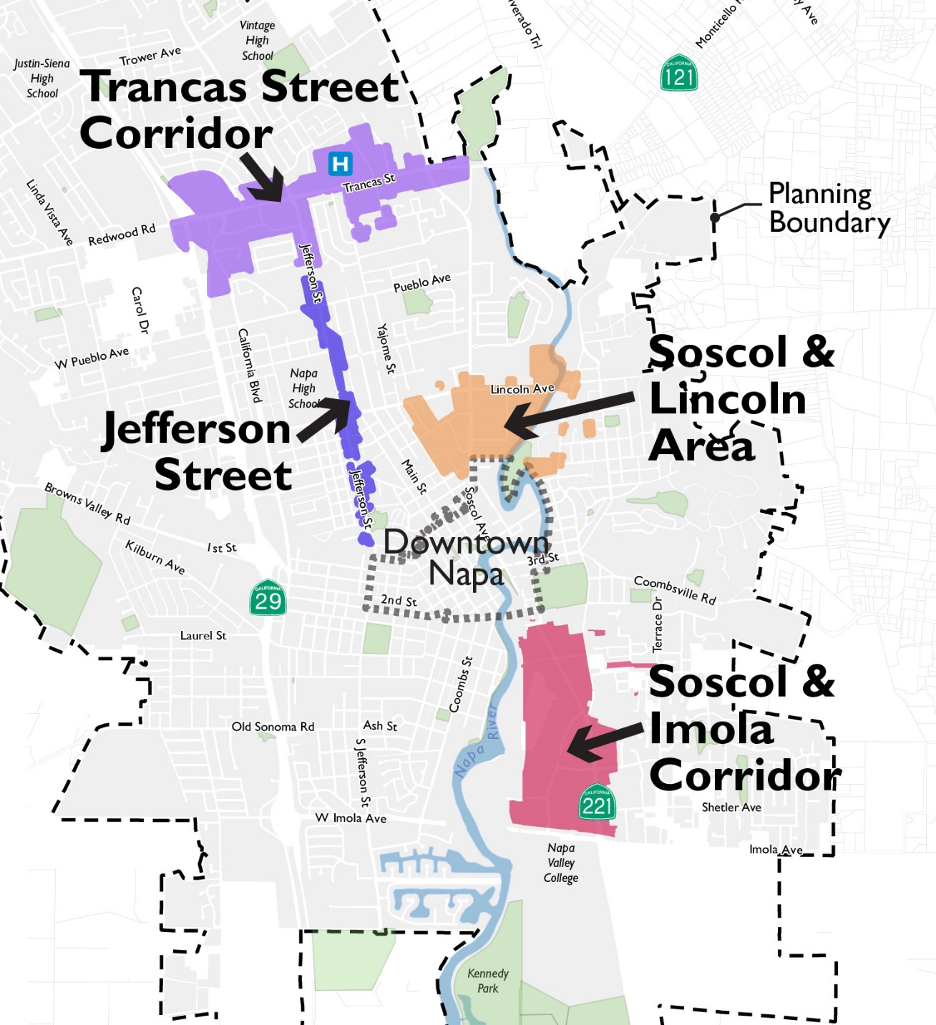
Corridors and
Downtown

Slide 19
Jefferson Street

Slide 20
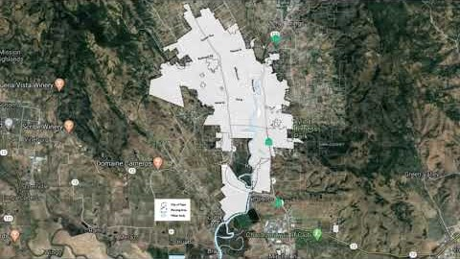

Slide 21
Jefferson Street:
Question 1: Which of the following do you support (check all you support):
Pedestrian comfort + safety (sidewalks/crossings)
More street trees
Bike-lanes or bicycle signage
On-street parking
Mixed-use development (housing or office above commercial)

Slide 22
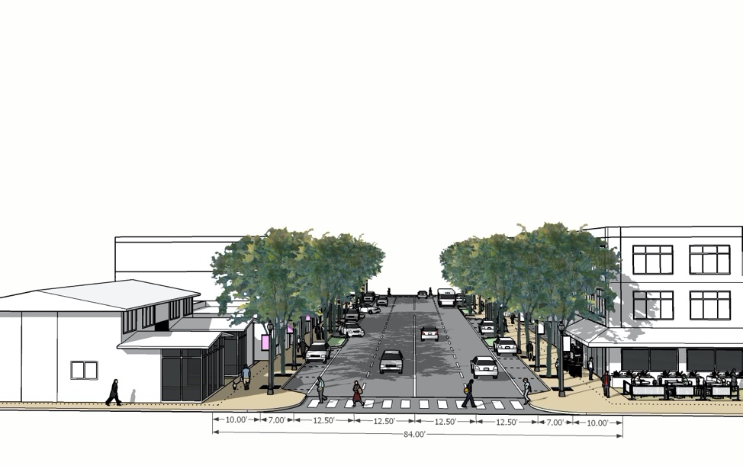
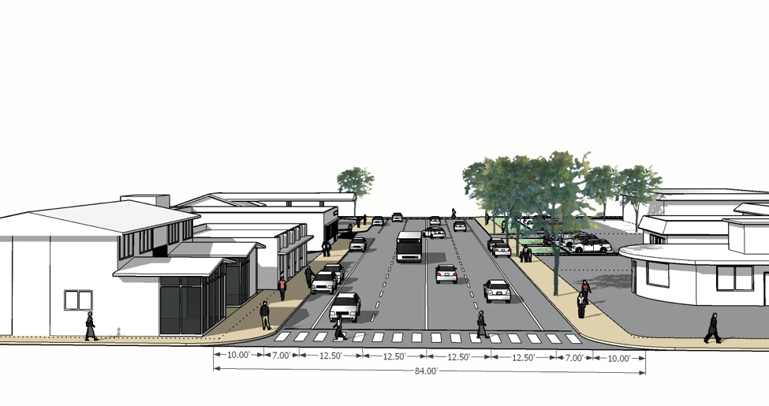
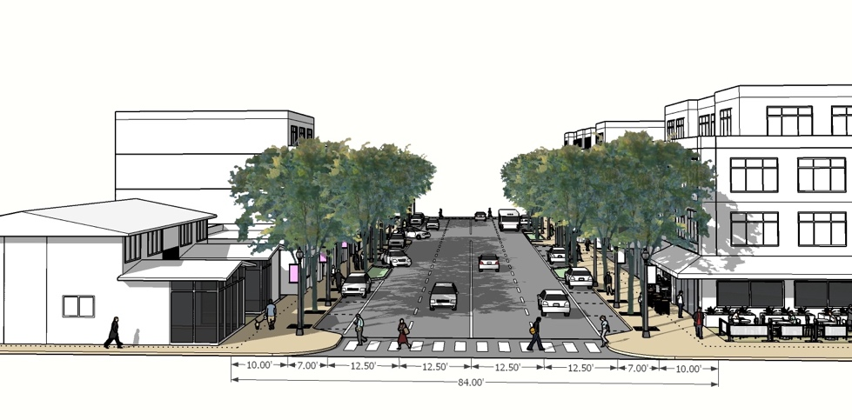
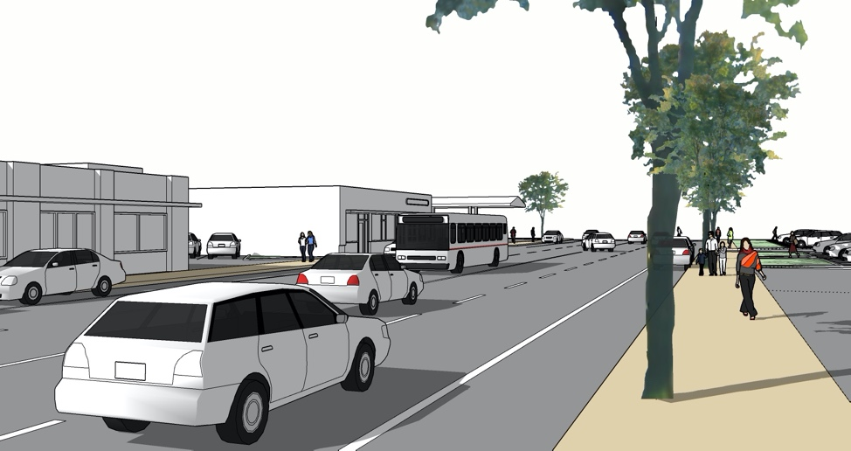
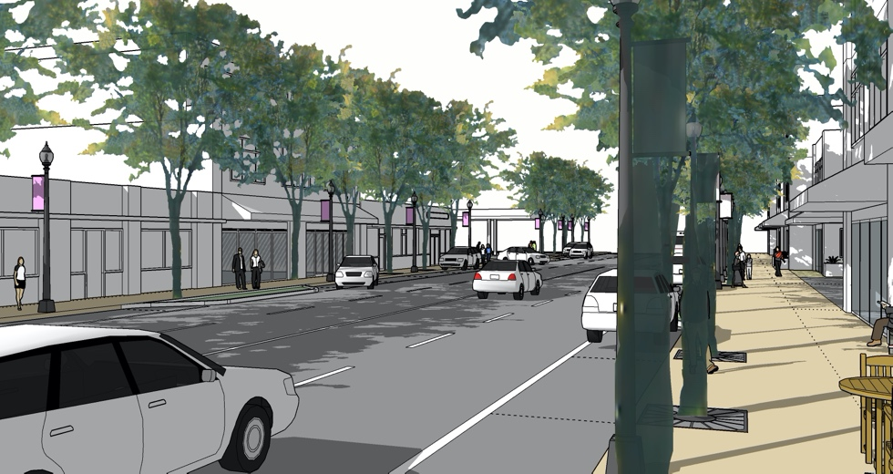
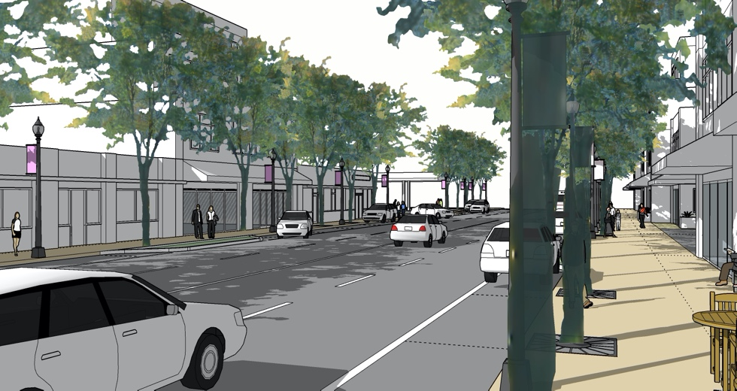
Jefferson Street:
Question 2: Which one of the options do you like best?
A.
Keep as is - currently allowed heights between 35 to 40 feet or three to four stories and no streetscape improvements.
B.
Keep currently allowed building heights and improve streetscapes and pedestrian orientation of buildings.
C.
Increase allowed heights by one story (50 to 55 feet, or 4 stories) in portions with well-designed, pedestrian-oriented buildings, and streetscape improvements.

Slide 23
Trancas Street

Slide 24
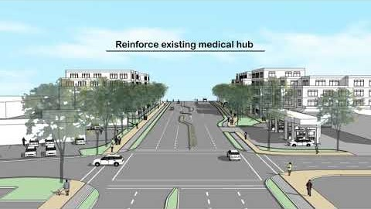

Slide 25
Trancas Street:
Question 1: Which of the following do you support (check all you support):
Pedestrian comfort + safety (sidewalks/crossings)
More street trees
Bike-lanes or bicycle signage
Mixed-use development (housing or office above commercial)

Slide 26
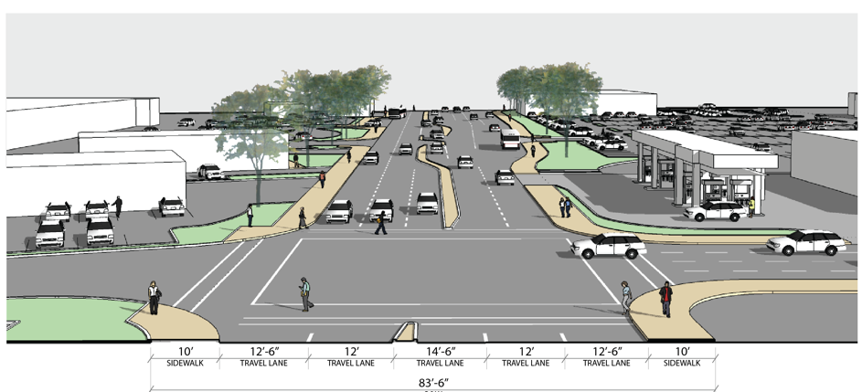
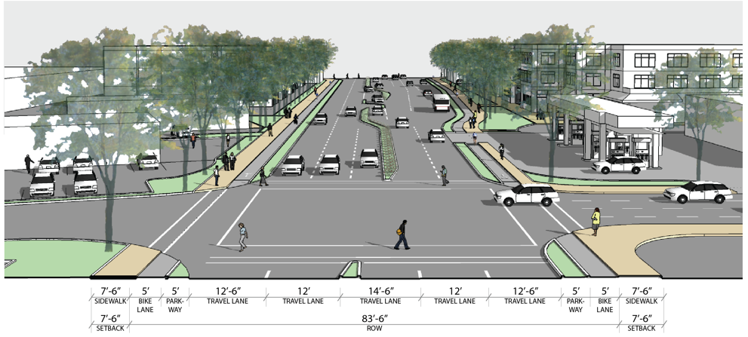
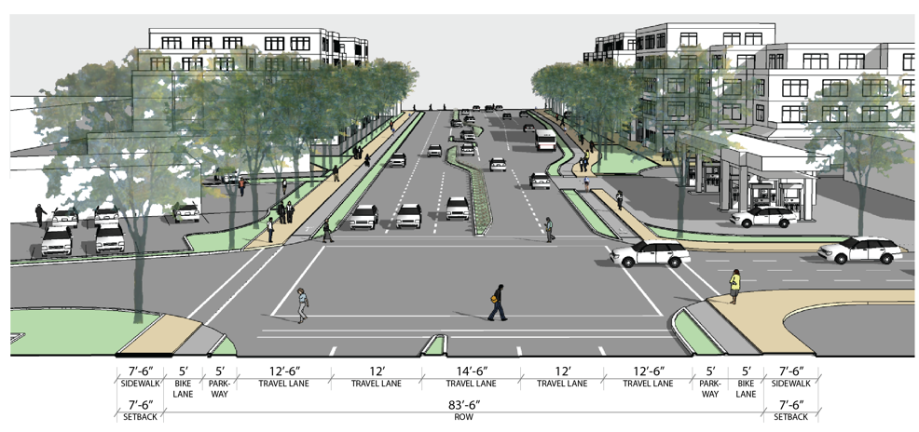
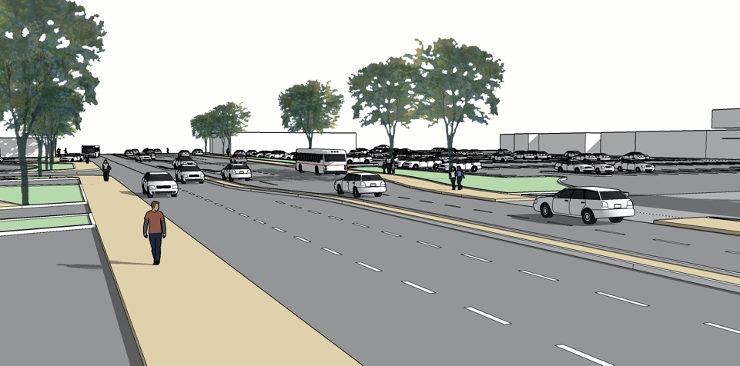
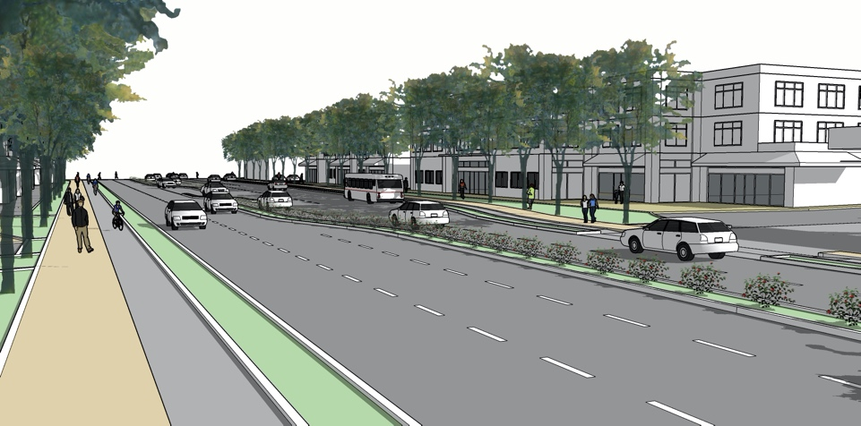
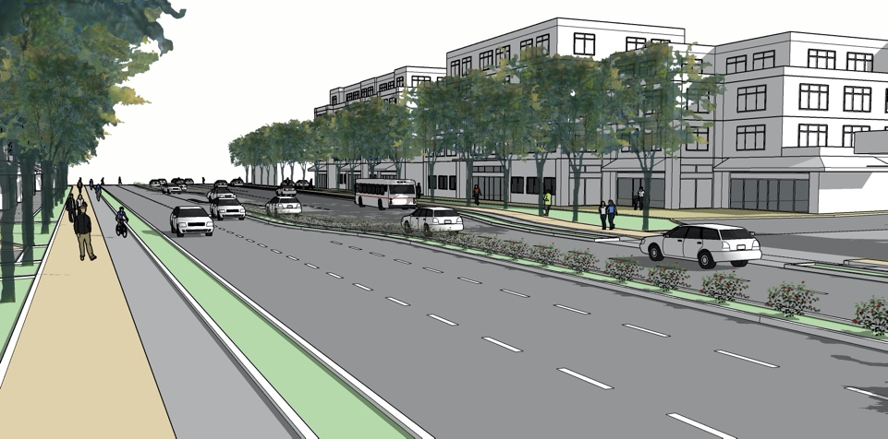
Trancas Street:
Question 2: Which one of the options do you like best?
A.
Keep as is - currently allowed heights between 35 to 40 feet or three to four stories and no streetscape improvements.
B.
Keep currently allowed building heights and improve streetscapes and pedestrian orientation of buildings.
C.
Increase allowed heights by two stories (55 to 60 feet, or 5 stories) in portions with well-designed, pedestrian-oriented buildings, and streetscape improvements.

Slide 27
Soscol and Lincoln Focus Area

Slide 28
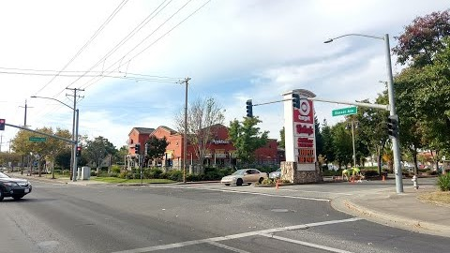

Slide 29
Soscol and Lincoln:
Question 1: Which of the following do you support (check all you support):
Pedestrian comfort + safety (sidewalks/crossings)
More street trees
Bike-lanes or bicycle signage
On-street parking
Mixed-use development (housing or office above commercial)
Maker or production-oriented uses
Continuous open space spine along Napa River, with buildings oriented to the river

Slide 30
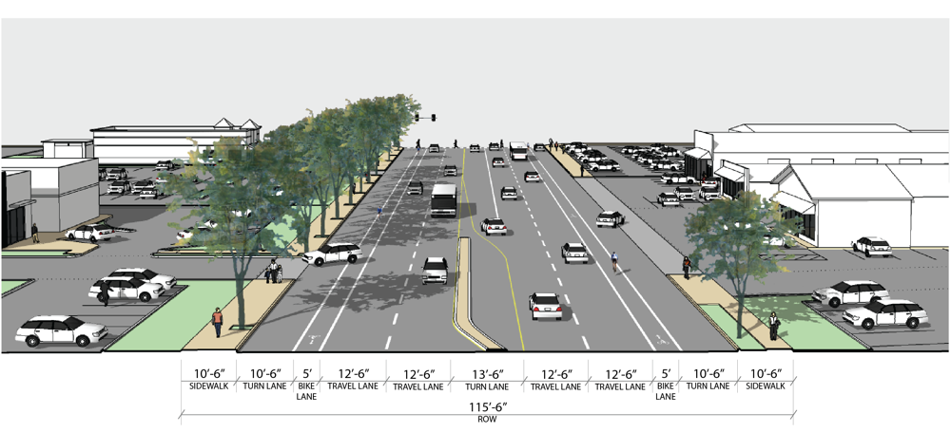
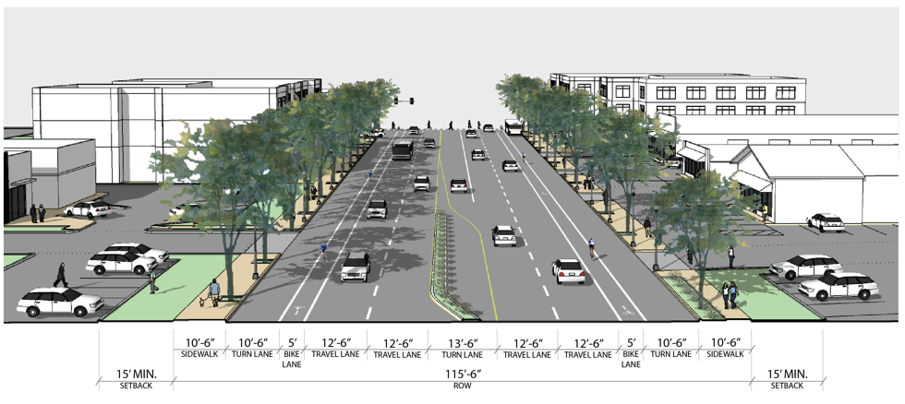
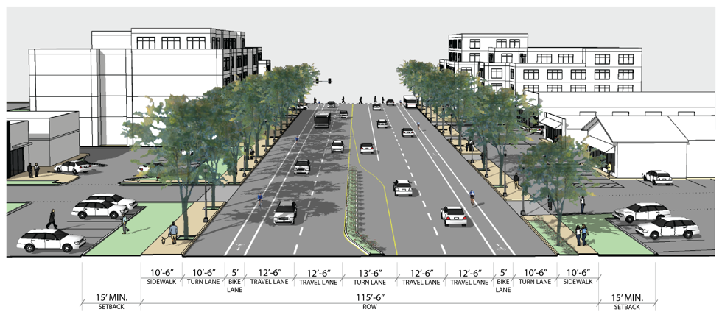
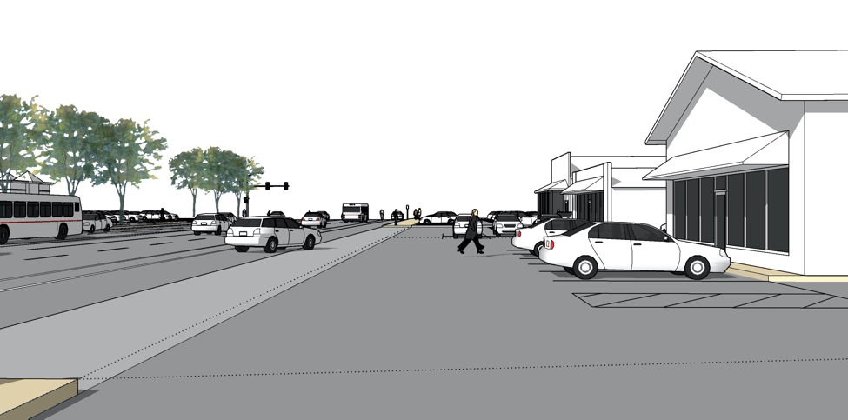
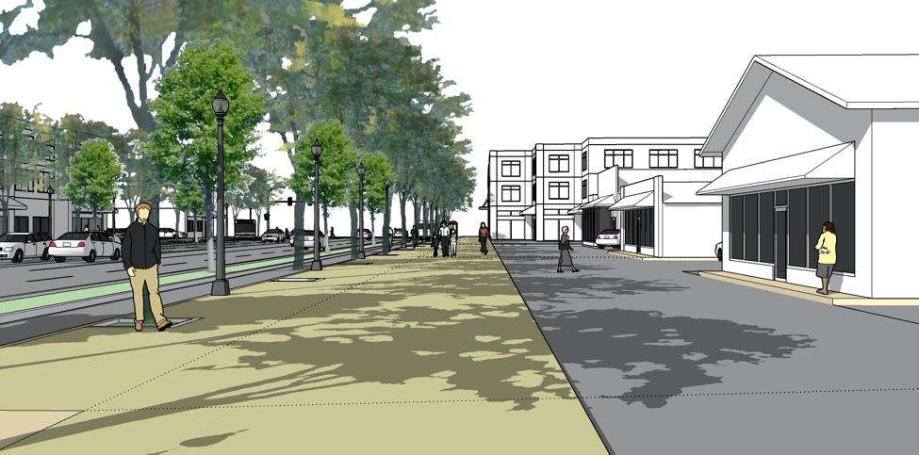
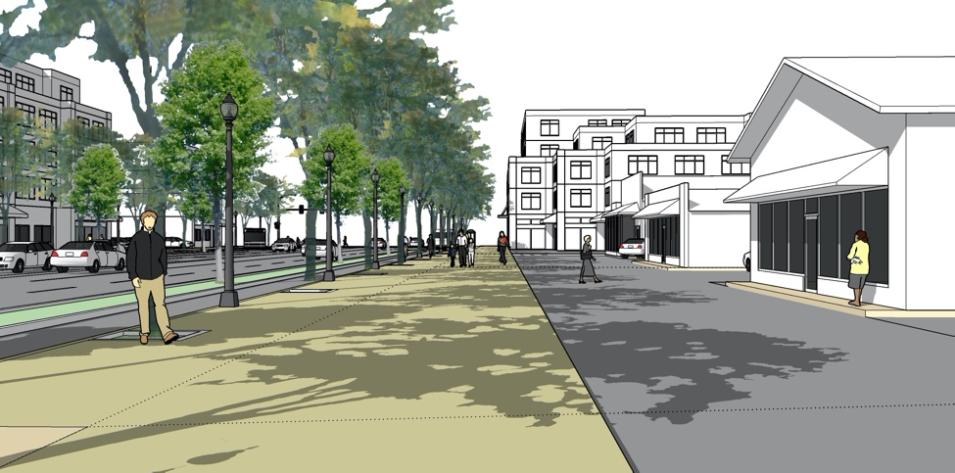
Soscol and Lincoln:
Question 2: Which one of the options do you like best along Soscol?
A.
Keep as is - currently allowed heights of up to 40 feet or three to four stories and no streetscape improvements.
B.
Keep currently allowed building heights and improve streetscapes and pedestrian orientation of buildings.
C.
Increase allowed heights by two stories (55 to 60 feet, or 5 stories) in portions with well-designed, pedestrian-oriented buildings, and streetscape improvements.

Slide 31
Soscol and Imola Focus Area

Slide 32
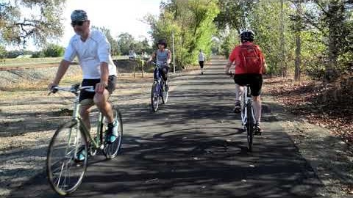

Slide 33
Soscol and Imola:
Question 1: Which of the following do you support (check all you support):
Pedestrian comfort + safety (sidewalks/crossings)
More street trees
Bike-lanes or bicycle signage
Mixed-use development (housing or office above commercial)

Slide 34
Soscol and Imola:
Question 2: Which one of the options do you like best?
A.
Keep as is - currently allowed heights of up to 40 feet or three to four stories and no streetscape improvements.
B.
Keep currently allowed building heights and improve streetscapes and pedestrian orientation of buildings.
C.
Increase allowed heights by two stories (55 to 60 feet, or 5 stories) in portions with well-designed, pedestrian-oriented buildings, and streetscape improvements.

Slide 35
4. Conclusion and Next Steps

Slide 36
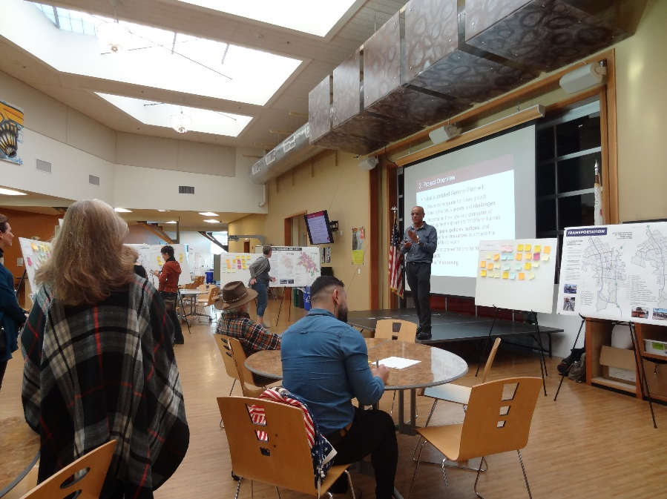
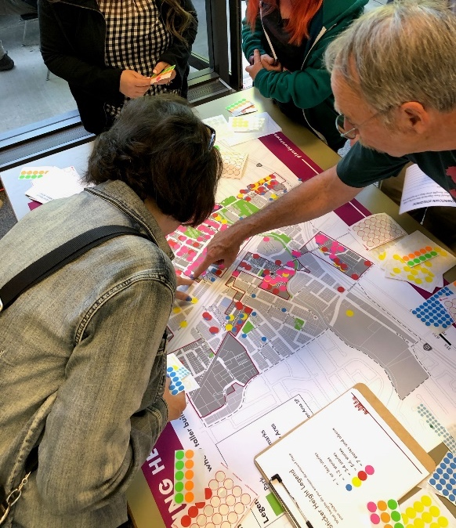
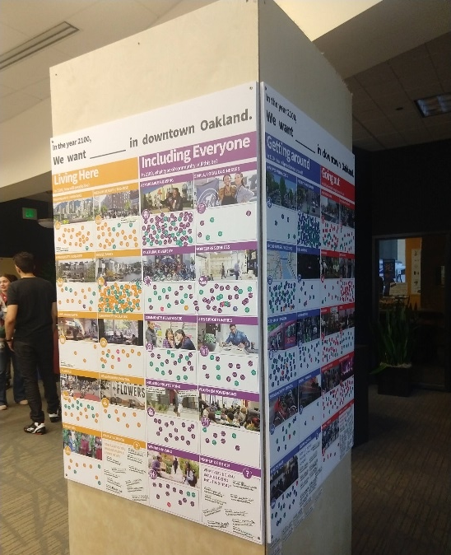
Further Community Outreach Opportunities
Additional workshops and community outreach are part of the General Plan process
Digital or in-person as feasible with COVID-19
Additional opportunities when Preferred Plan is prepared in fall

Slide 37
Project Resources
Check out Napa2040.com for the most up-to-date information, including:
  Current City Plans and Documents
  General Plan Documents
    Existing Conditions Report
    Economics, Demographic, and Real Estate Profile
    Community Draft Vision and Guiding Principles
    Draft Land Use and Urban Design Approach
    General Plan Advisory Committee meeting summaries
    Reports on community outreach
    Student research papers and more!

Slide 38
Contact
If you have any additional questions, please contact Michael Walker, Senior Planner for the City of Napa, at mwalker@cityofnapa.org
Thank you for helping plan
Napa’s future!

Slide 39
City of Napa General Plan Update
PREFERRED PLAN AND CONCEPTS

